Slide 1
Les acteurs du suivi gynécologique, une interdisciplinarité nécessaire ou imposée ?Le point de vue de l’U
Pr. A.Gompel
Unité Gynécologie Endocrinienne,
Cochin-Port Royal, CRéAK
Paris

Slide 2
Passé
Formation 3ans CES 120/130/an très Gynécologique, variable selon régions
+ internes 4ans formation plus interdisciplinaire
Qualification : compétence≠specialité
Résultats:
dépistage cancer du col effectif sans DO
Mammographie idem
9% hystérectomies
Couverture contraception ++

Slide 3
Présent
DES 4 ans , 48 DES /an /France
Formation Gorganique, hormonologie, oncologie gyencologique et mammaire, AMP
Post internat >80% des cas, masters 15-16%
DESC reproduction 40%, oncologie 10%, médecine légale, infectieux…
Une dizaine de thèses de sciences en cours

Slide 4
Avenir
Reforme CNIPI
4 ans DES 1 année socle, 2 ans consolidation
1 an mise en responsabilité
Chaque réforme diminue la formation mutidisciplinaire….
Devenir CCA (retaurer fonction HU)
et assistants???
Nombre?
Role des généralistes et sages femmes? Filières de soins, délégation de taches
Formation, Actes, Encadrement, organisation des maisons médicales ??
Sages femmes n insuffisant pour suivi grossesse…

Slide 5
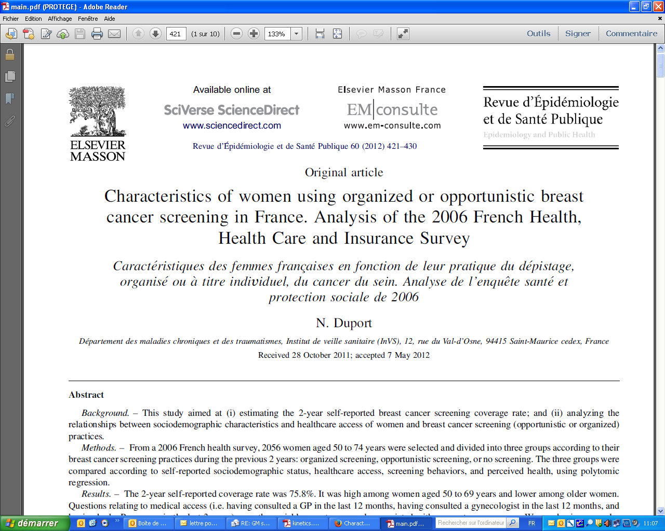
ORs
for screening participation
if consulting a gynecologist: 1,7(1,3-2,1)
A GP: 06(0,4-1)

Slide 6
DIU
Contraception. 2014 Jan;89(1):9-16. doi: 10.1016/j.contraception.2013.10.003. Epub 2013 Oct 21.
IUD use in France: women's and physician's perspectives.
Moreau C¹, Bohet A, Hassoun D, Ringa V, Bajos N; FECOND group.
Abstract
OBJECTIVE:
While the intra-uterine device (IUD) is the second most popular contraceptive method in France, its use remains low among women most at risk of unintended pregnancies. Acknowledging the conjoint role of women and physicians in contraceptive decision making, we investigate the determinants of IUD use and IUD recommendations from the user and prescriber perspectives.
STUDY DESIGN:
Data are drawn from 2 national probability surveys (population-based and physician surveys) on sexual and reproductive health in France. The population based survey comprised 3,563 women ages 15-49 at risk of an unintended pregnancy in 2010 and the physician survey included 364 general practitioners (GPs) and 401 gynecologists practicing in private offices in 2010-2011. Analyses were performed using logistic regression models.
RESULTS:
Altogether, 21.4% of women were IUD users, with substantial differences by age and parity. Less than 1% of young women (<25 years) and 3% of nulliparous were current IUD users in 2010. The odds of IUD use were four times higher in women followed by a gynecologist as compared to a GP. Mirroring these results, gynecologists were more likely to recommend IUDs than GPs. Misconception about IUD risks was widespread among women and providers. Medical training and information, professional practice settings, and ever use of IUDs also informed physician's likelihood of recommending IUDs, regardless of specialty.
CONCLUSIONS:
The study reveals the intersection of individual and professional influences on contraceptive use patterns. The considerable age discrepancy in IUD use in France, with very few young women most at risk of an unintended pregnancy using the method, reflects a knowledge gap shared by users and providers. These findings suggest there are significant opportunities to improve contraceptive care in France.
IMPLICATIONS:
This study stresses the need to inform women and doctors about the benefits and risks of IUDs for all women. Substantial efforts are required to improve the medical curriculum, in order to promote evidenced based family planning counseling and provide GPs with the technical skills to insert IUDs.

Slide 7
En conclusion?
Principe: mieux former les acteurs de la santé des femmes
→C’est notre rôle
Mais: moyens limités
Qui se charge d’évaluer la compétence des uns et des autres?
Les généralistes enseignent aux généralistes, les GO,SF aux SF, DUs
Expérience clinique??
En Suède : 40 ans d’expérience et évaluation très stricte et régulière

Slide 8
En route vers le futur

